Slide 1
Reimagined Fairy Tales

Slide 2
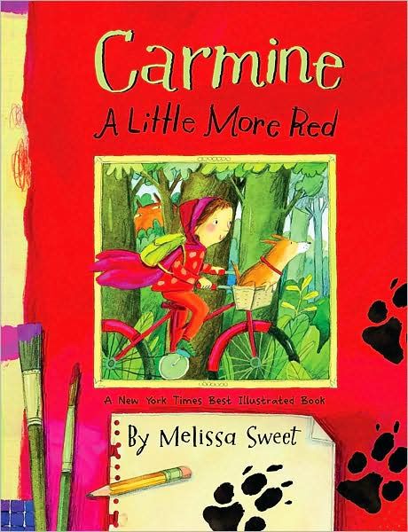

Slide 3
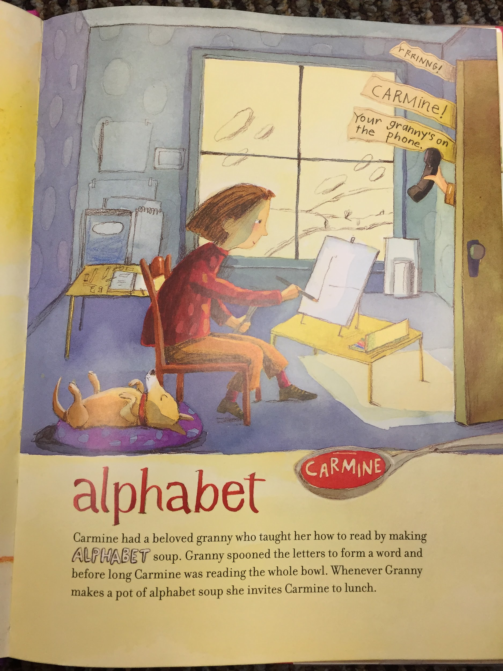
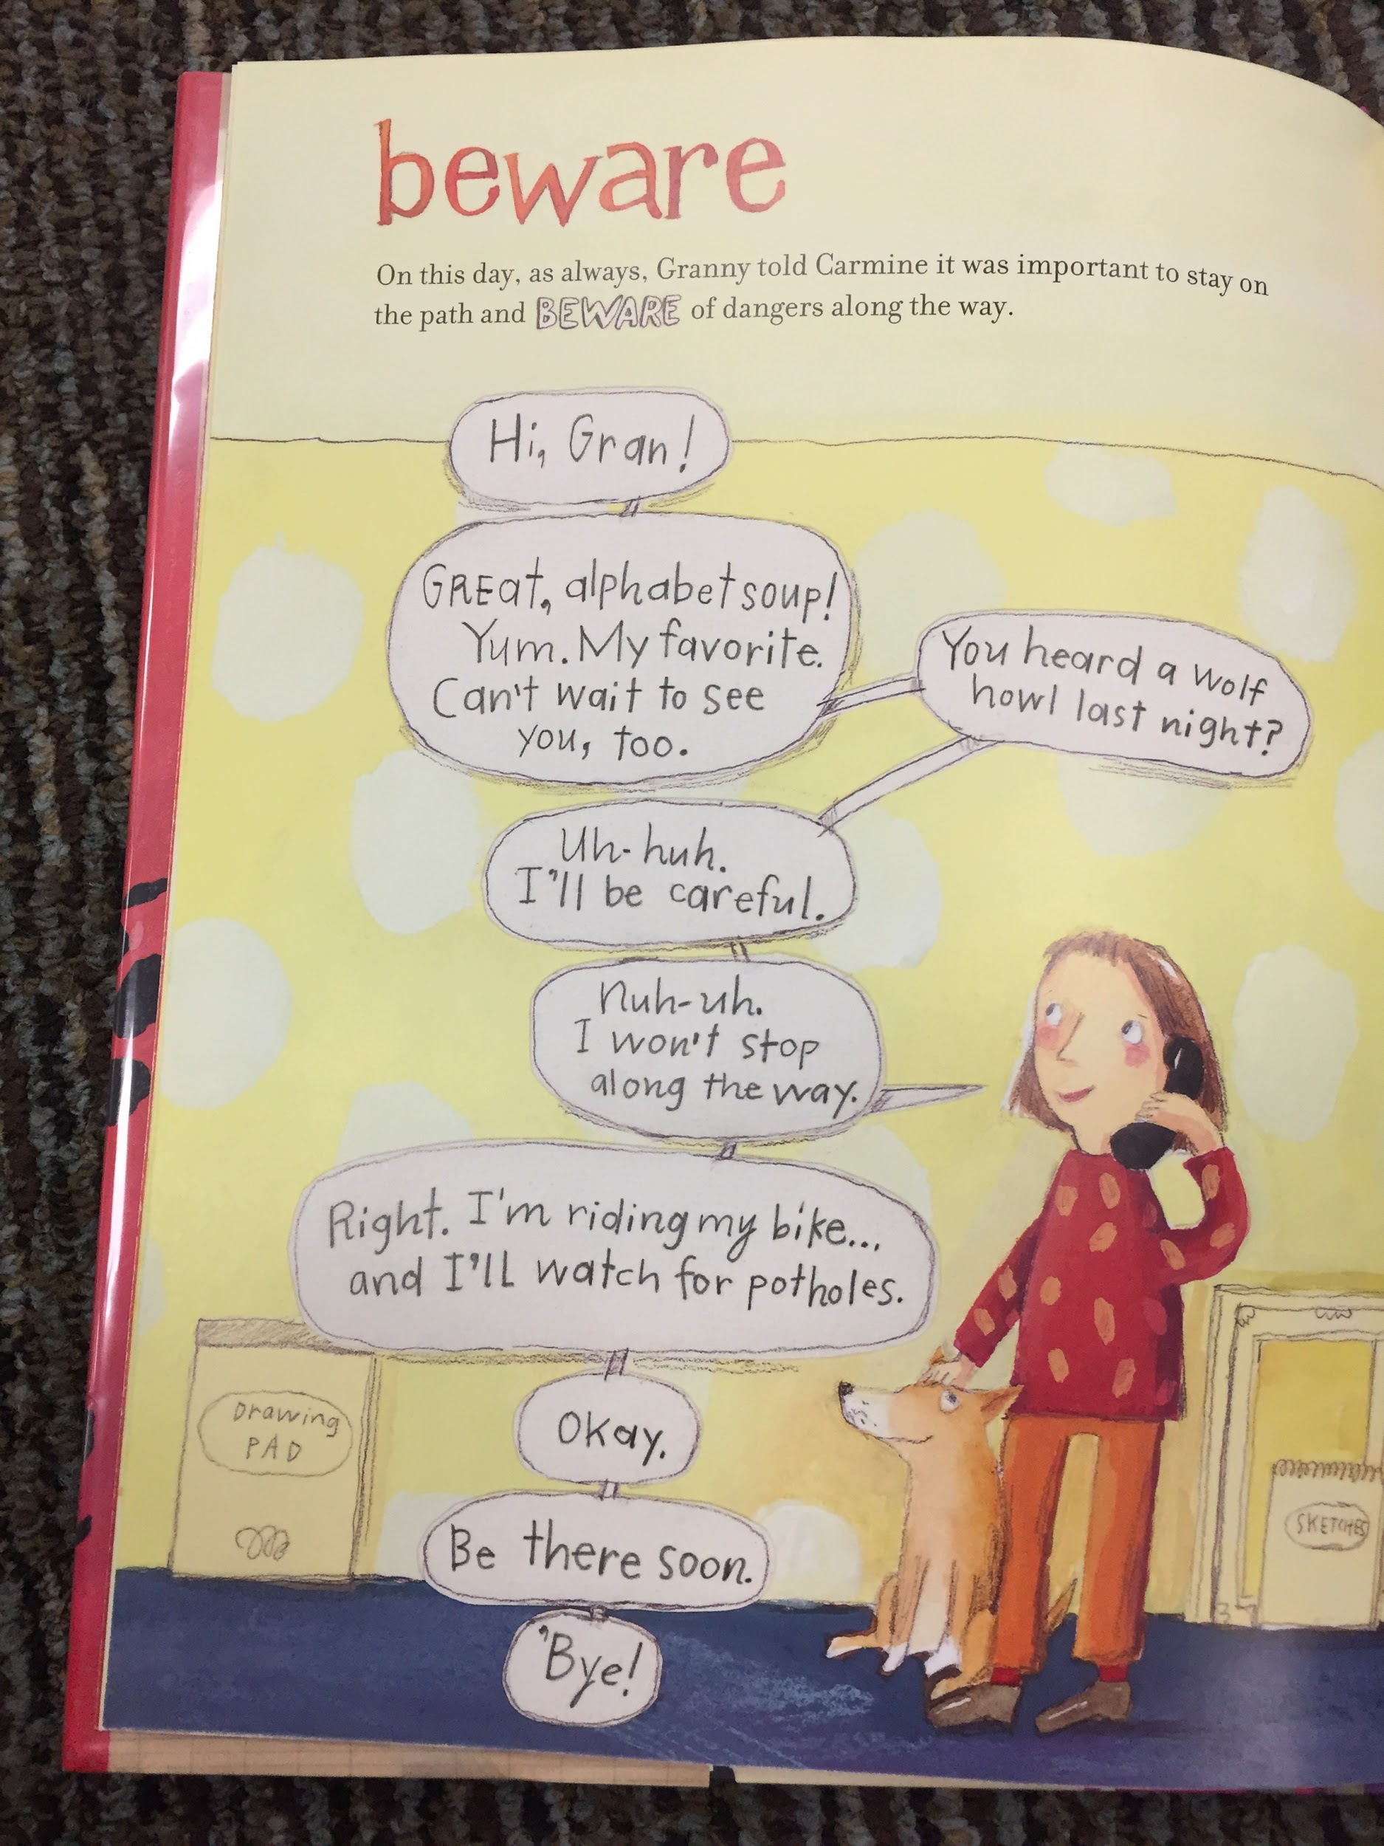

Slide 4
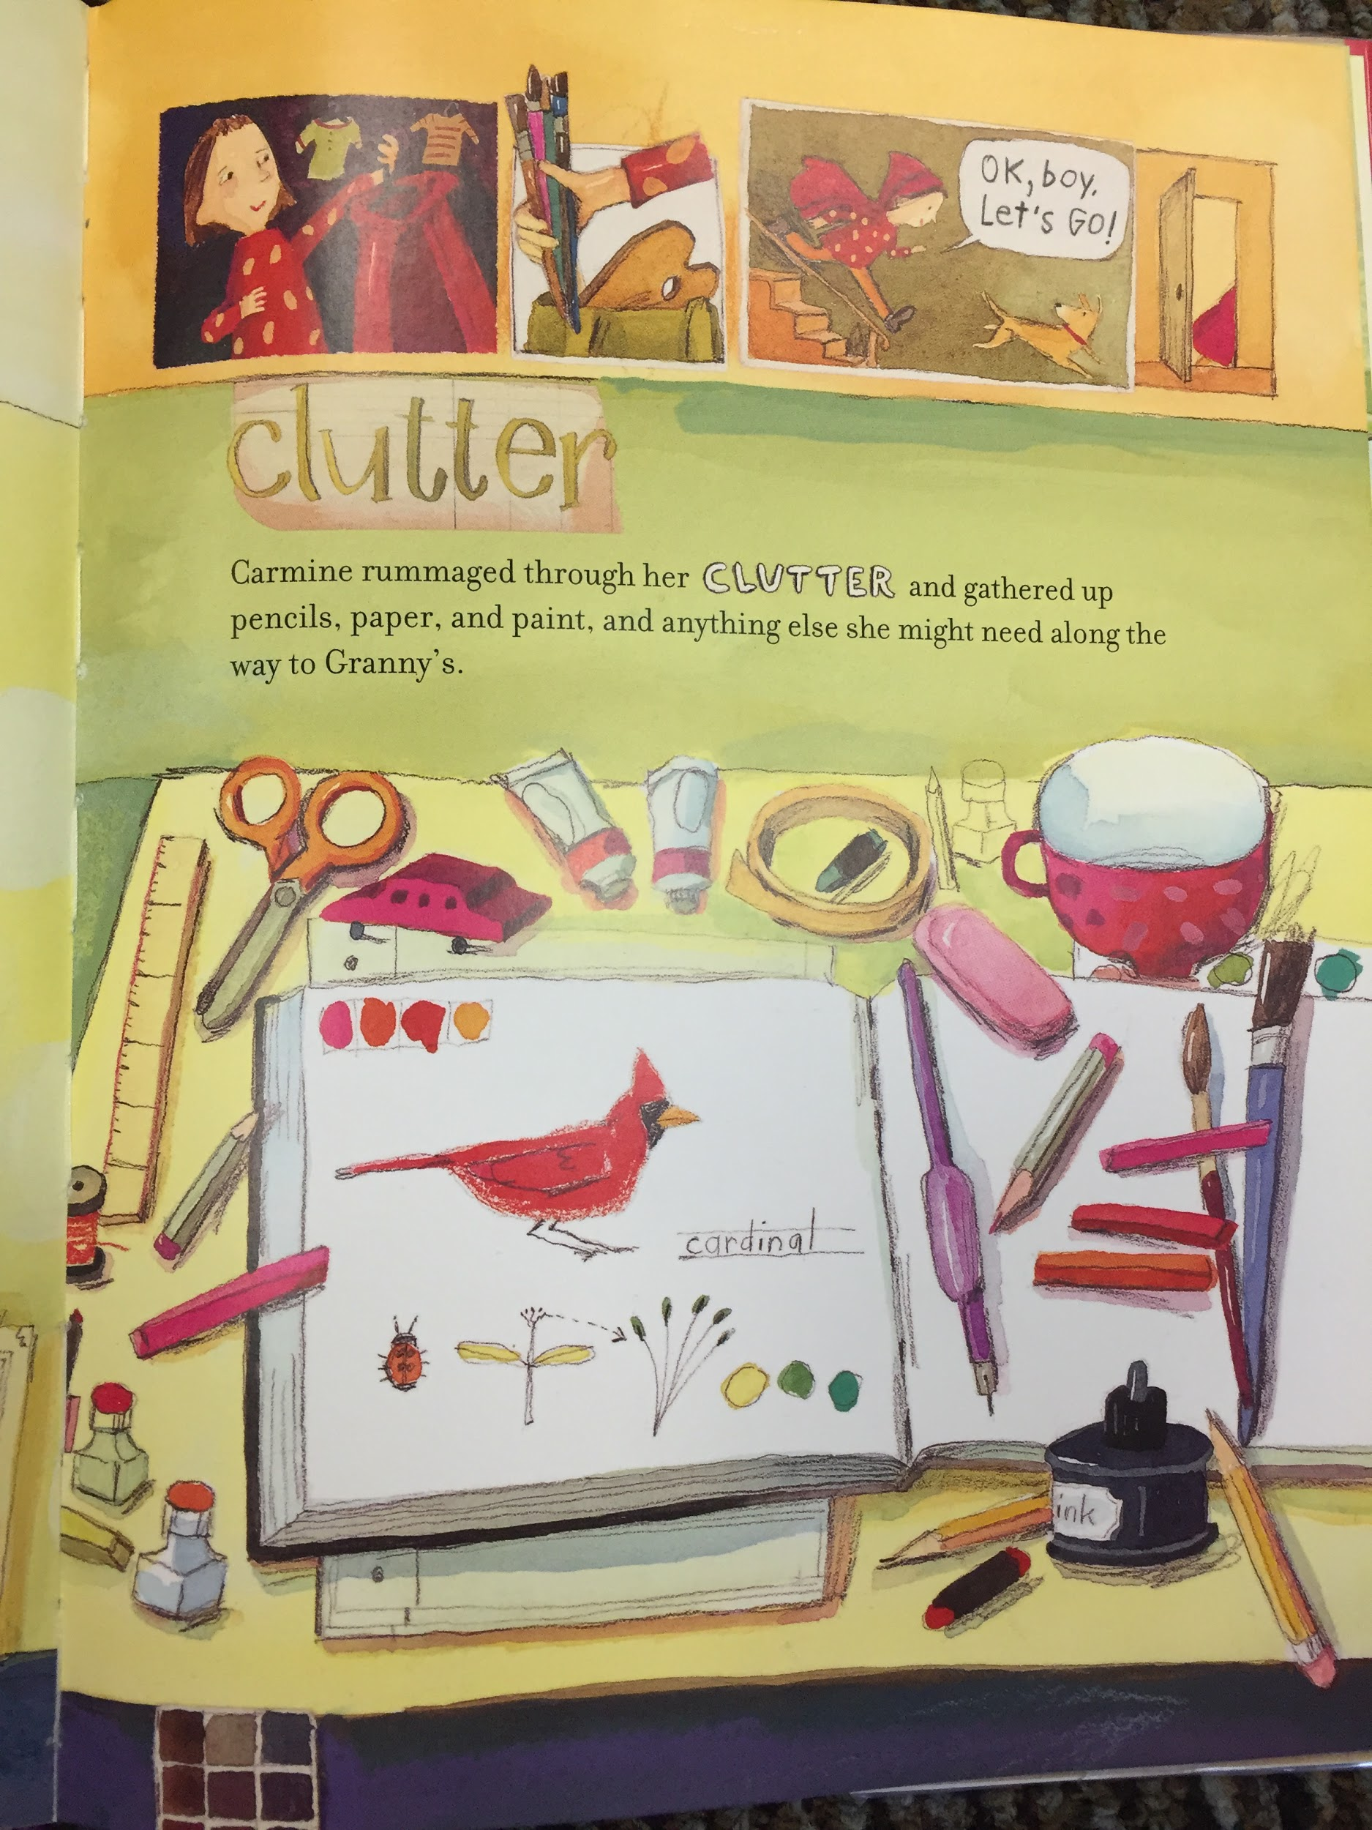
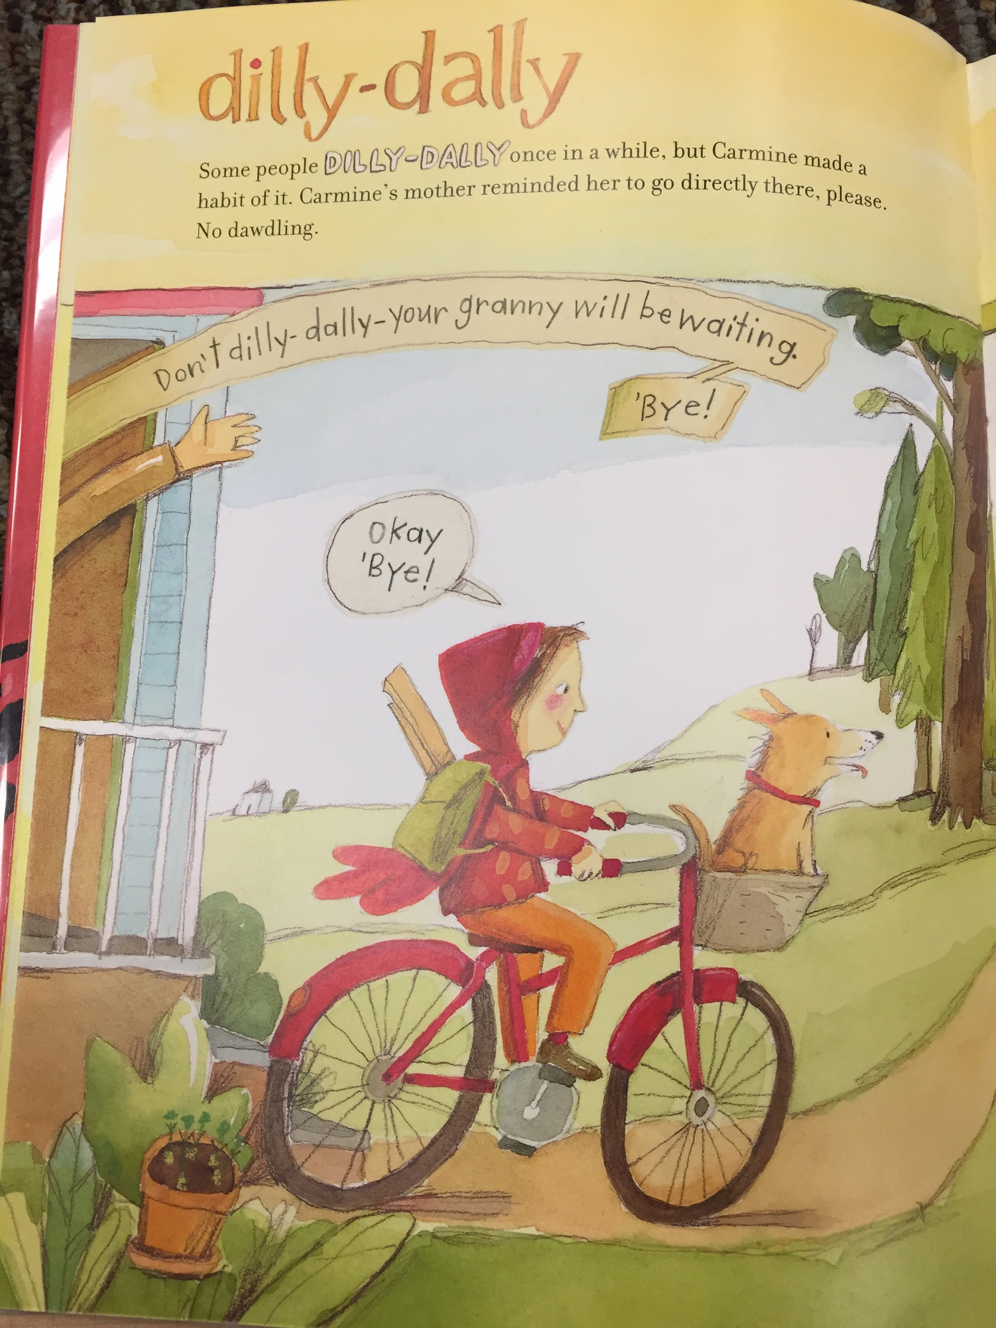

Slide 5
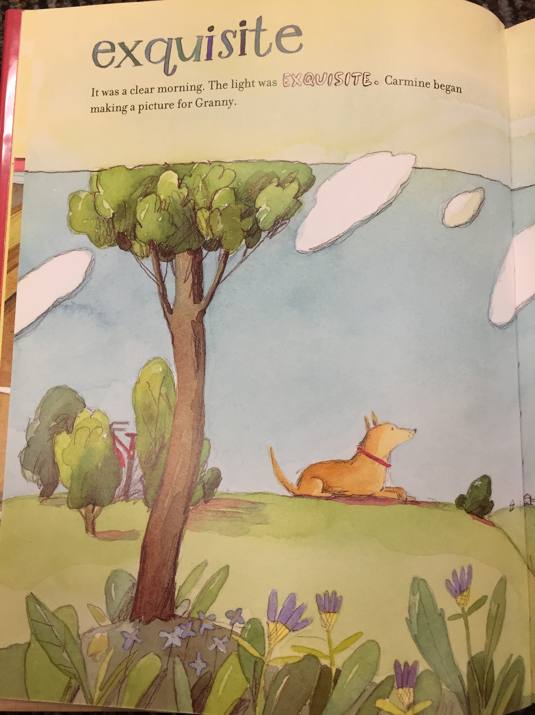
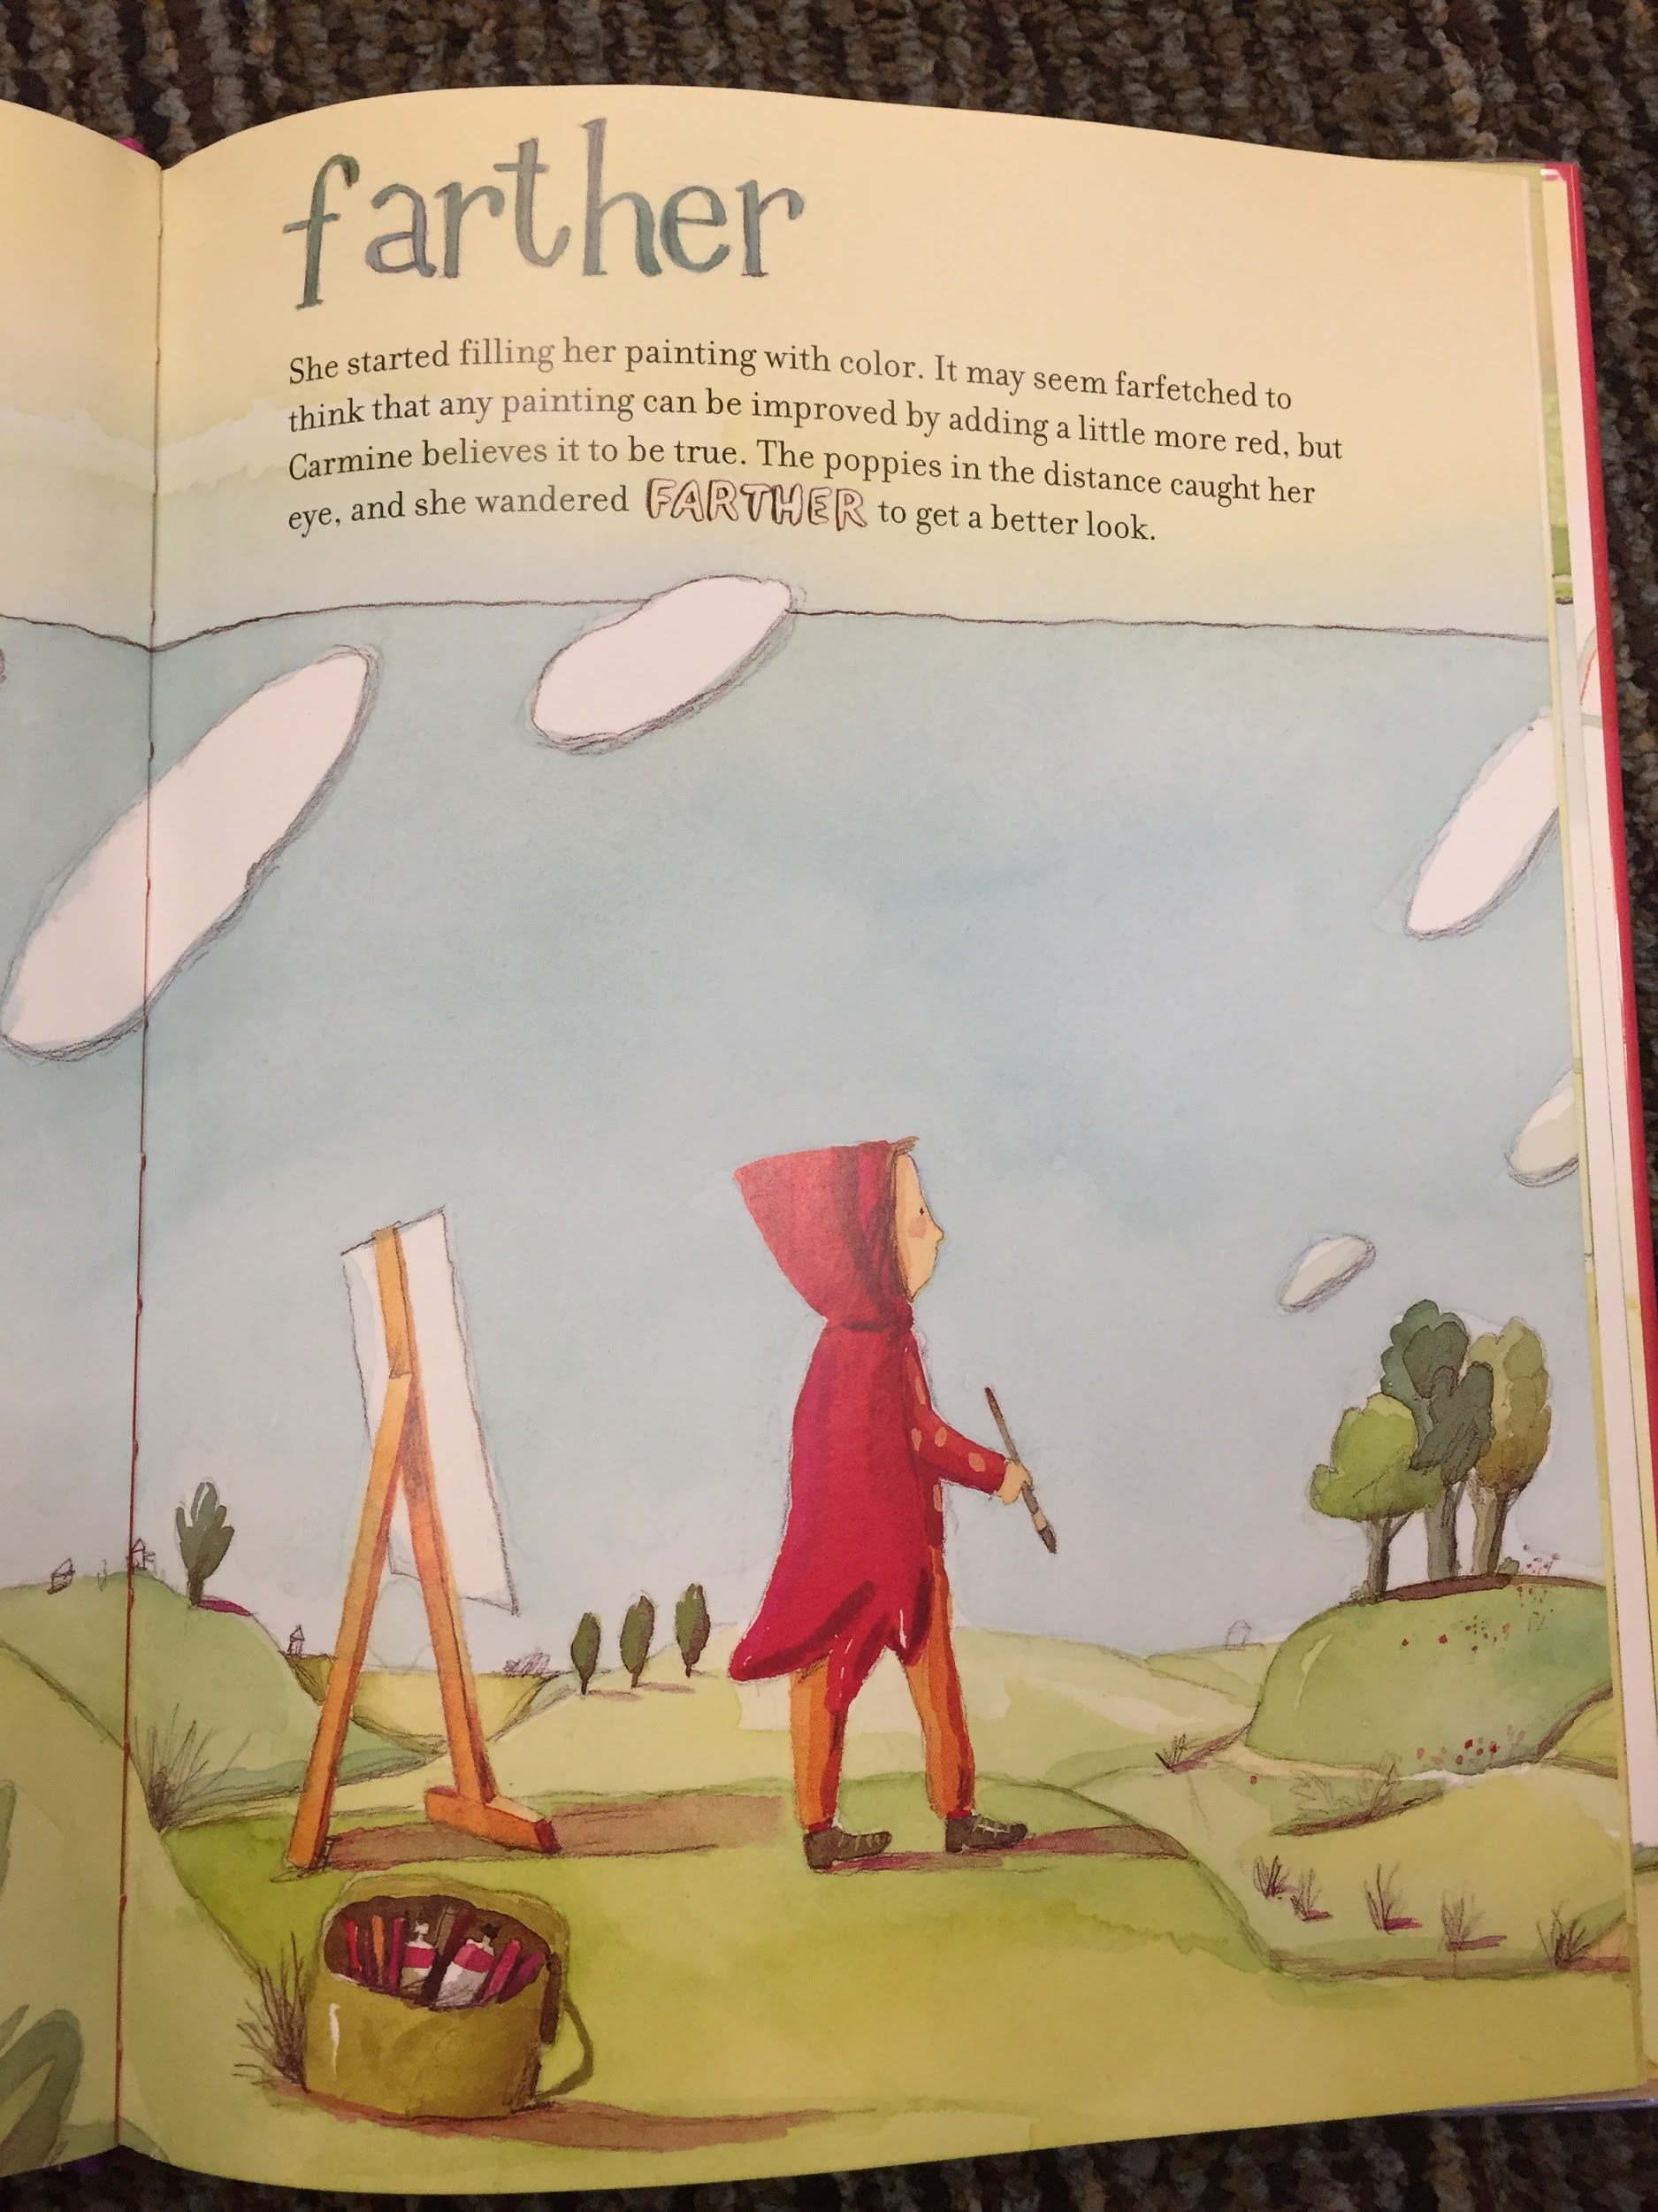

Slide 6
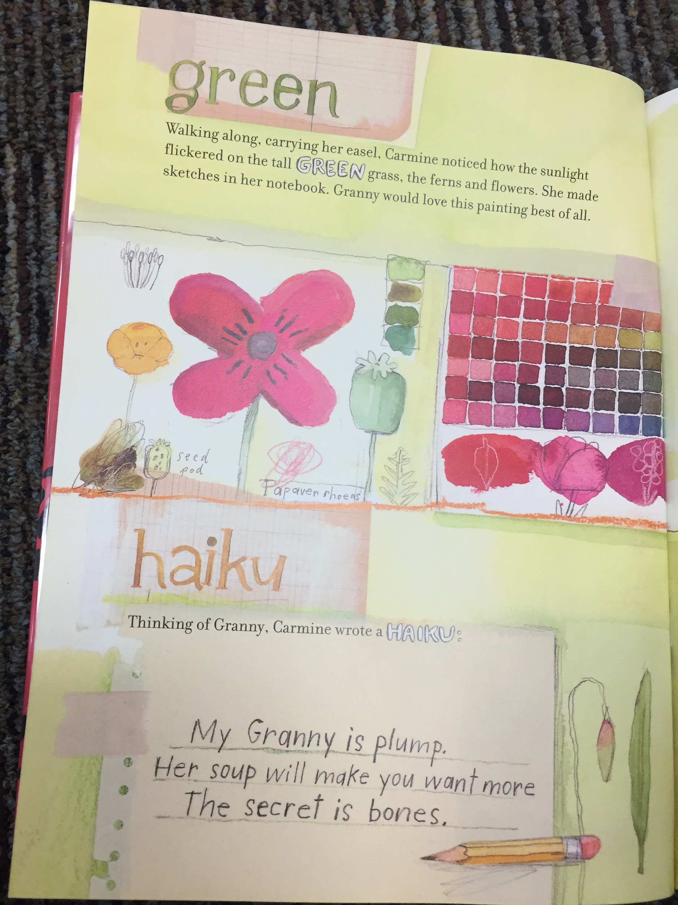
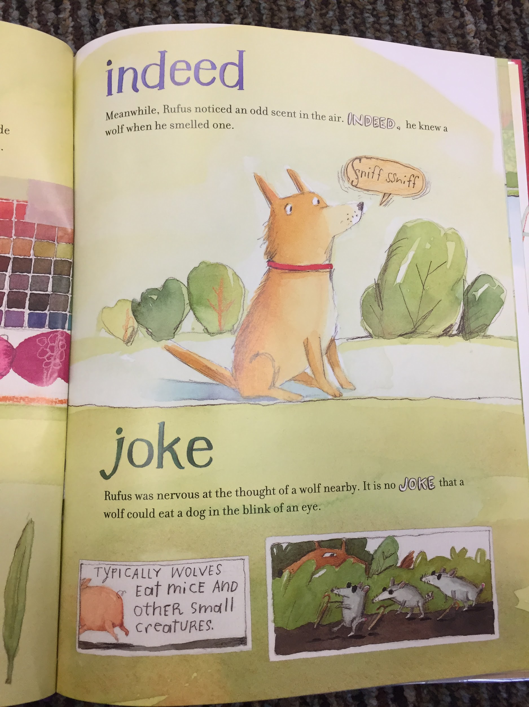

Slide 7
Notice that...
The alphabet letters do not need to start the sentence
The unconventional title of the story
The Author uses many descriptive words (adjectives) throughout the story, such as “exquisite”
Use of dialogue with Carmine to her Granny
How does that add to the story?
The vivid illustrations

Slide 8
Now you try!
Try creating your own short version of the Little Red Riding Hood. I have provided blank books for you.
Try incorporating a sequence of four letters from the alphabet such as A-D or E-H
You may use dialogue to enhance your story.
You may come up with a surprising title for your story.
Try adding colorful illustration to your pages.
Remember your alphabet letter does not need to start the sentence.

