Slide 1
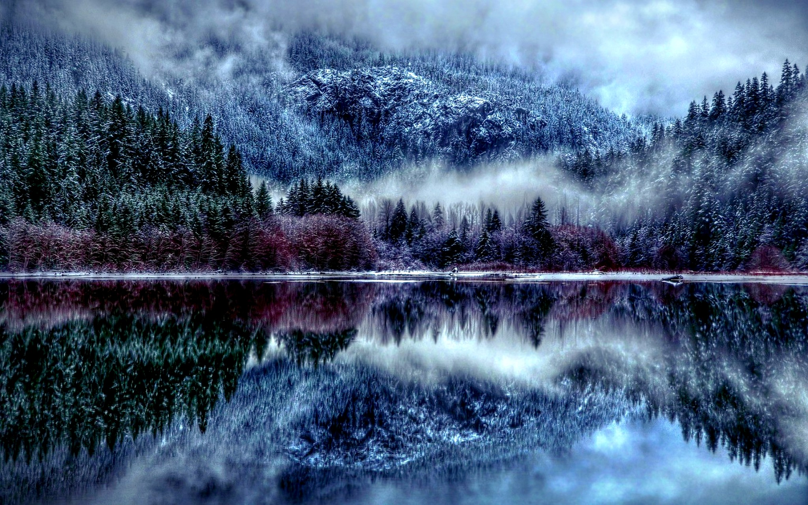
“Wintergirls”
Written By: Laurie Halse Anderson
Book Trailer Created By: Lorrennis Leeds

Slide 2
The Pact
“I swear to be the skinniest girl in school, skinnier than you.” I say.
“I bet I’ll be skinnier than you.” Cassie says.
“No, don’t make it a bet. Let’s be skinniest together.”
“Okay, but I’ll be skinnier.”

Slide 3
Cassie, my BF
Me.

Slide 4
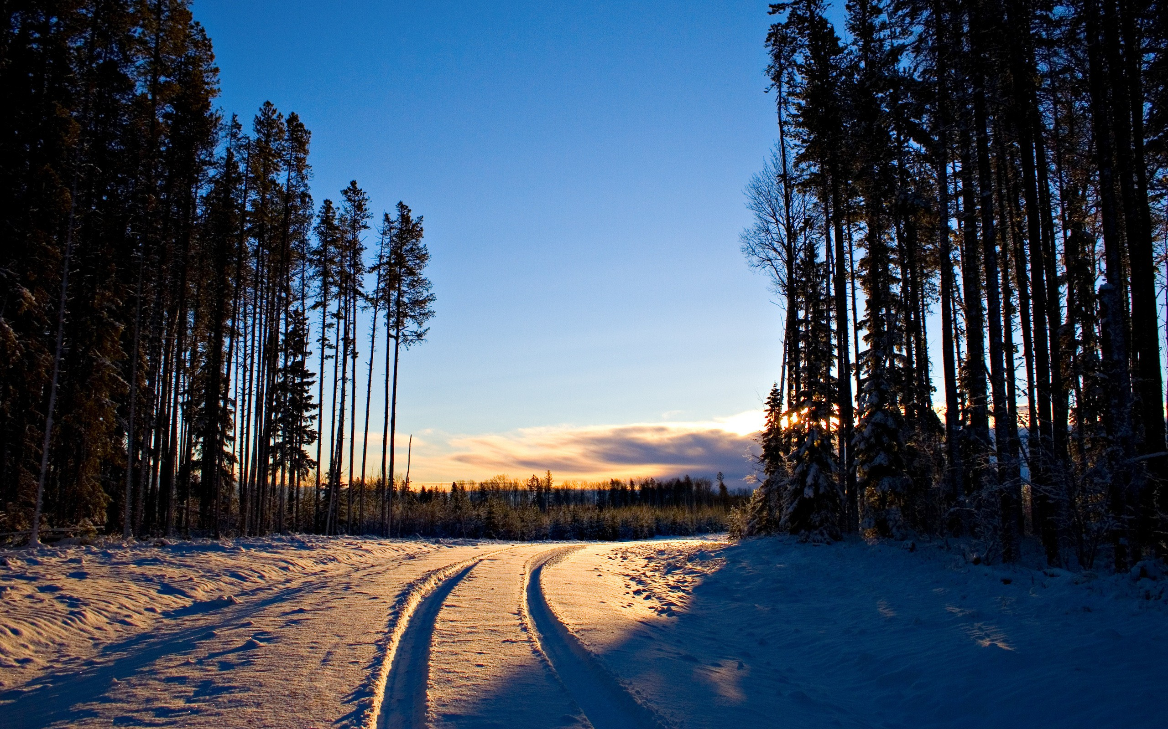
Lia and Cassie were best friends. Frozen in stick thin bodies.

Slide 5
…body found in a motel room, alone…
…she called me...
…thirty-three times.

Slide 6
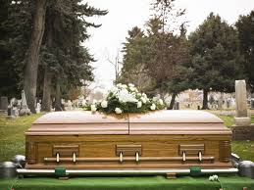
…the death of 19-year-old-Cassandra Parrish, whose body was discovered early Sunday morning in a room of the Gateway Motel…
…she called me thirty-three times.
1.2.3.4.5.6.7.8.9.10.11.12.13.14.15.16.17.18.19.20.21.22.23.24.25.26.27.28.29.30.31.32.33.

Slide 7
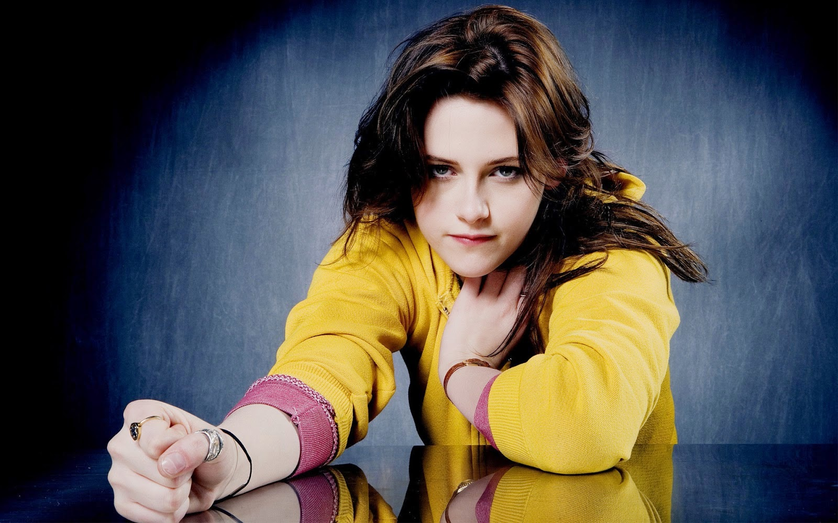
But now Cassie is DEAD. It’s not nice when girls die.

Slide 8
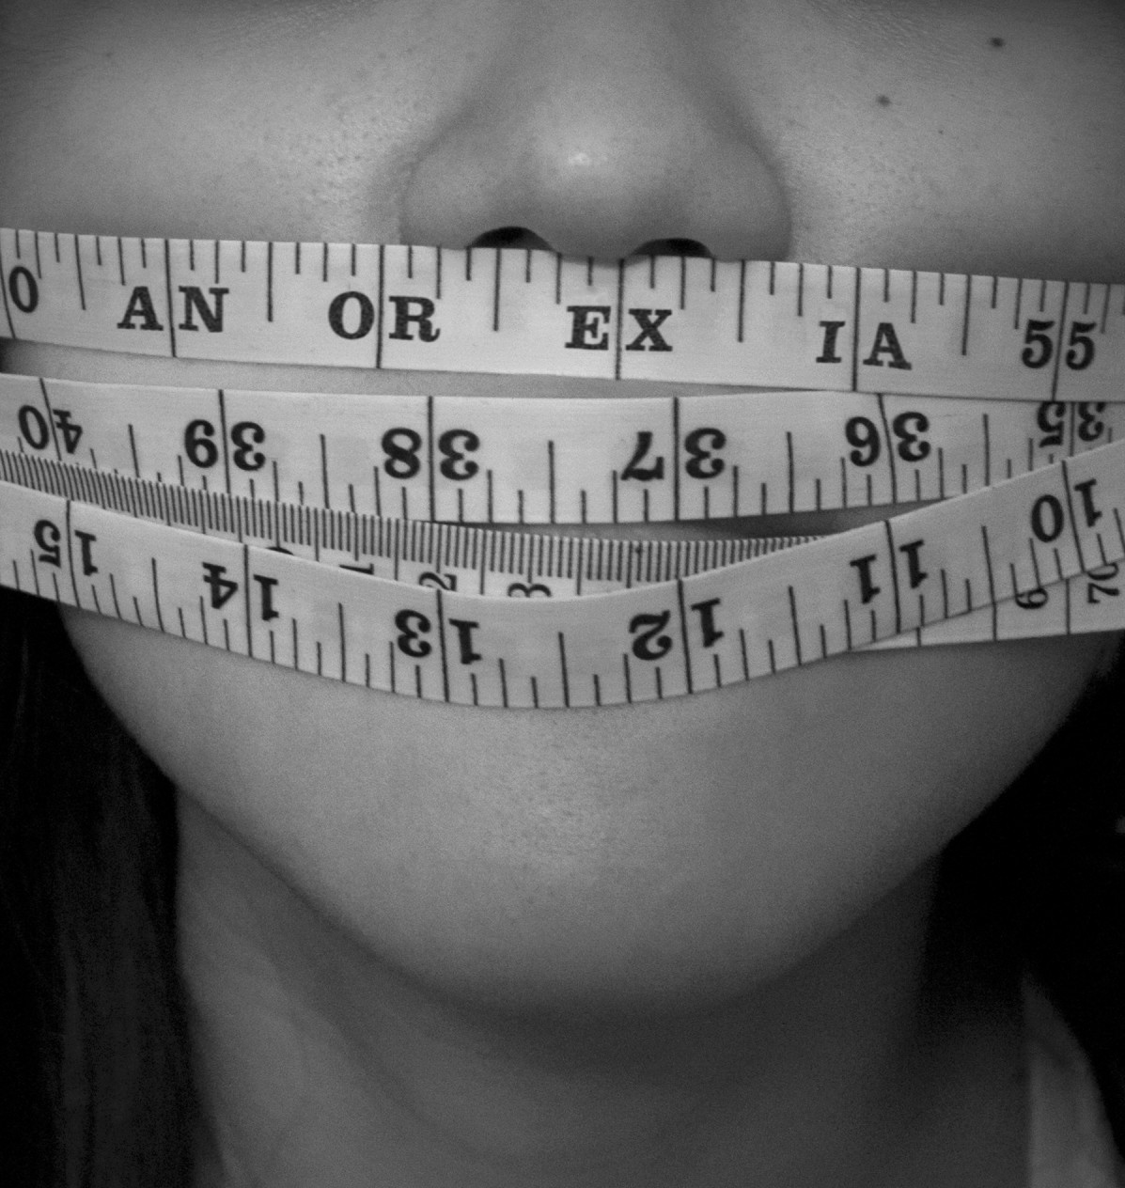
Because I can’t let myself want them because I don’t need a muffin (410), I don’t want an orange (75) or toast (87), and waffles (180) make me gag.
…”I’m having cereal.”
I could eat the entire box I probably won’t even fill my bowl.(pg. 5)

Slide 9
Goal # 1: 99lbs
Goal # 2: 95lbs.
Goal # 3: 90lbs.

Slide 10
Cassie watches me…”Give it up,” she whispers.

Slide 11
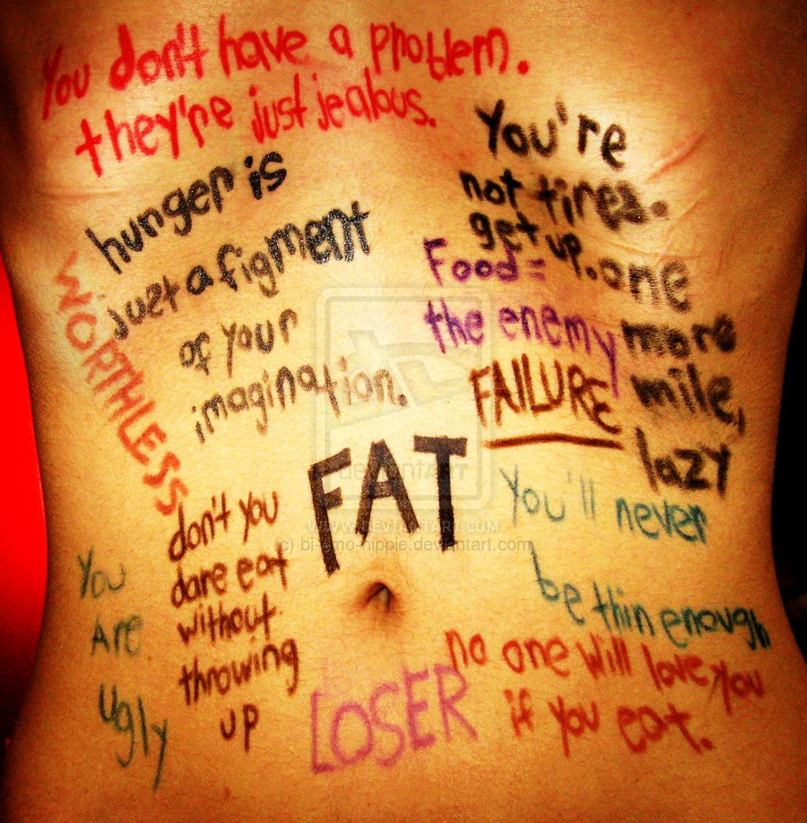

Slide 12
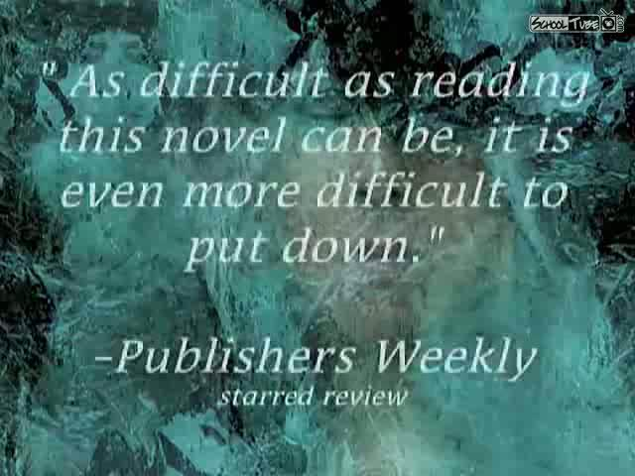

Slide 13
Lia’s whole family is clueless.

Slide 14
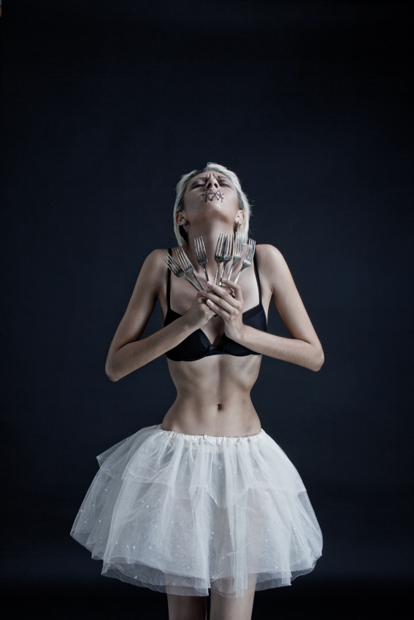
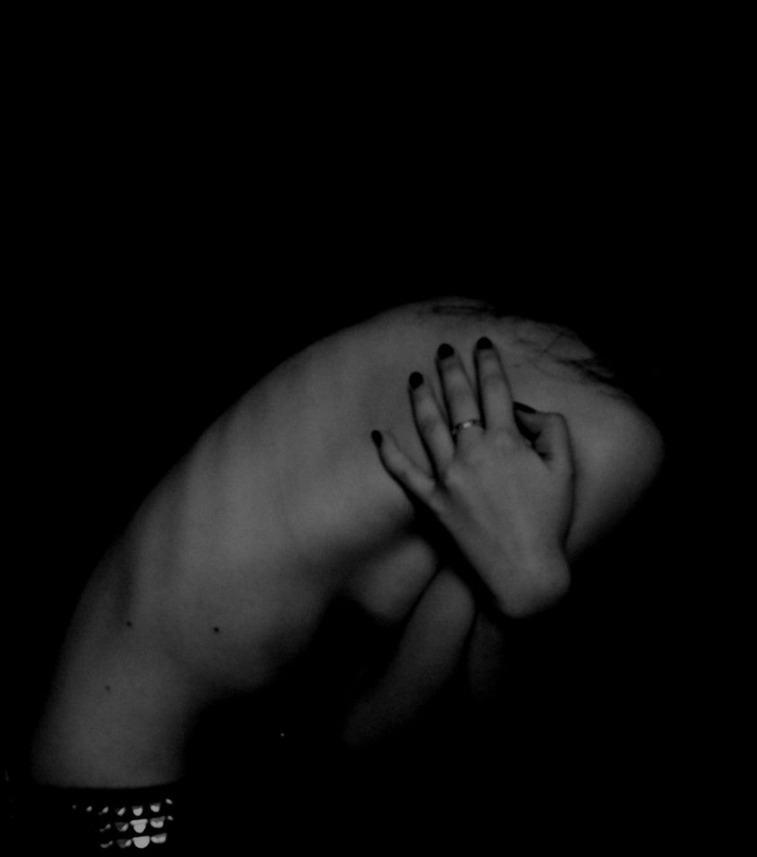
::Stupid/ugly/stupid/bitch/stupid/fat/
stupid/baby/stupid/loser/stupid/lost::

Slide 15
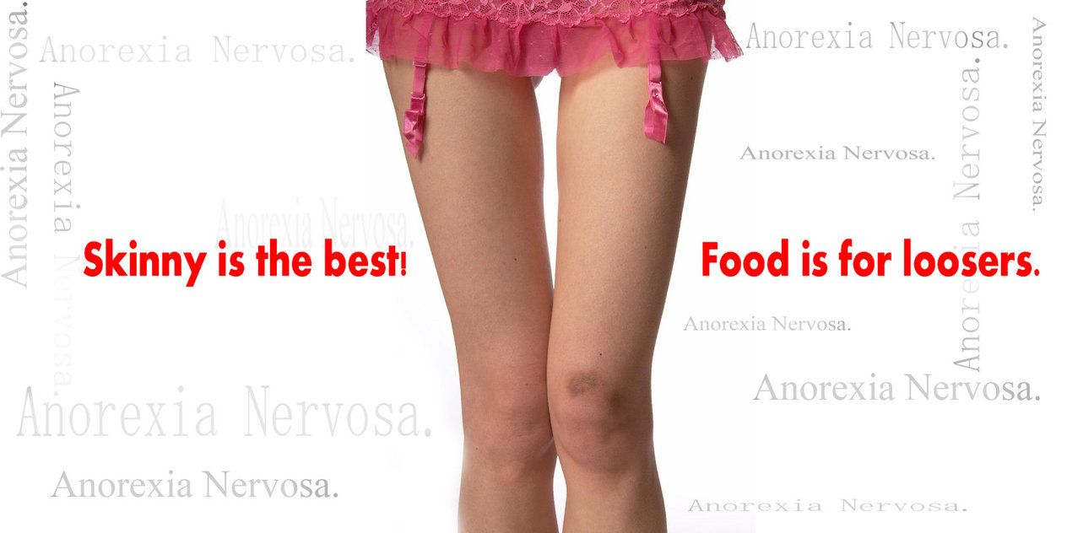
Must.Not.Eat.Must.Not.Eat.Must.Not.Eat.Must.Not.Eat.Must.Not.Eat.Must.Not.Eat.Must.Not.Eat.
Must.Not.Eat.Must.Not.Eat.Must.Not.Eat.Must.Not.Eat.Must.Not.Eat.Must.Not.Eat.Must.Not.Eat.Must.Not.Eat.Must.Not.Eat.Must.Not.Eat.Must.Not.Eat.Must.Not.Eat.Must.Not.Eat.Must.Not.Eat.Must.Not.Eat.Must.Not.Eat.Must.Not.Eat.Must Not Eat. Must NOT Eat. MUST. NOT. EAT.

Slide 16
I am strong enough to do this…empty/strong/breathe/pretend/hold on. “Not hungry”

Slide 17
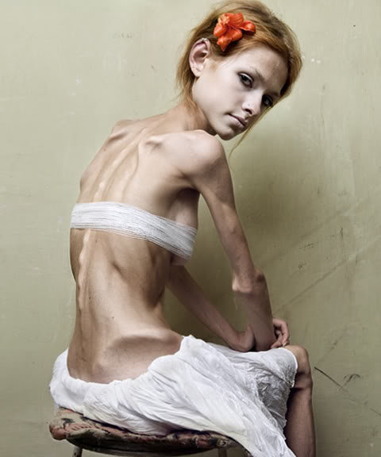
I inscribe three lines,
hush, hush, hush, into my skin.
Ghosts trickle out.(pg. 61)

Slide 18
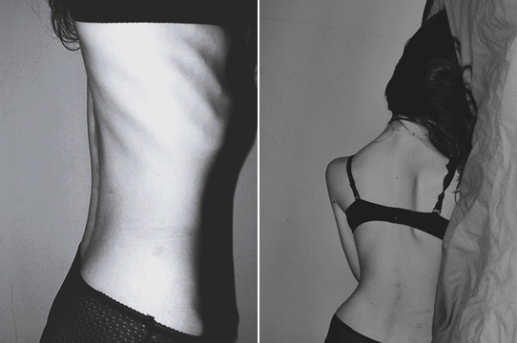
So tired…so hungry…must stay strong…must not eat.

Slide 19
We turned us into Wintergirls, and when Cassie tried to leave, I pulled her back into the snow because I was afraid to be alone.(99)

Slide 20
…she called.
thirty-three times.
you didn’t answer.
body found in a motel room, alone.
you left her alone.
should should should have done anything everything.
you killed her.
She almost went to a doctor two years ago.

Slide 21
WhatWhyWhenHowWho?
What am I afraid of?
Why can’t I even want to get better?
When am I me?
How do I know that ?
Who would I be?
How did I get like this?

Slide 22
“Please, Lia.” His voice has dropped to a whisper. “Please eat.”

Slide 23
If I got down to 70lbs…I want to be 65.
If I got to 10lbs…I would want to be 5lbs.
I wouldn’t be happy until I got down to…0 lbs.
Zero pounds.
Zero life.
Size Zero.
Double-Zero.
Zero point.

Slide 24
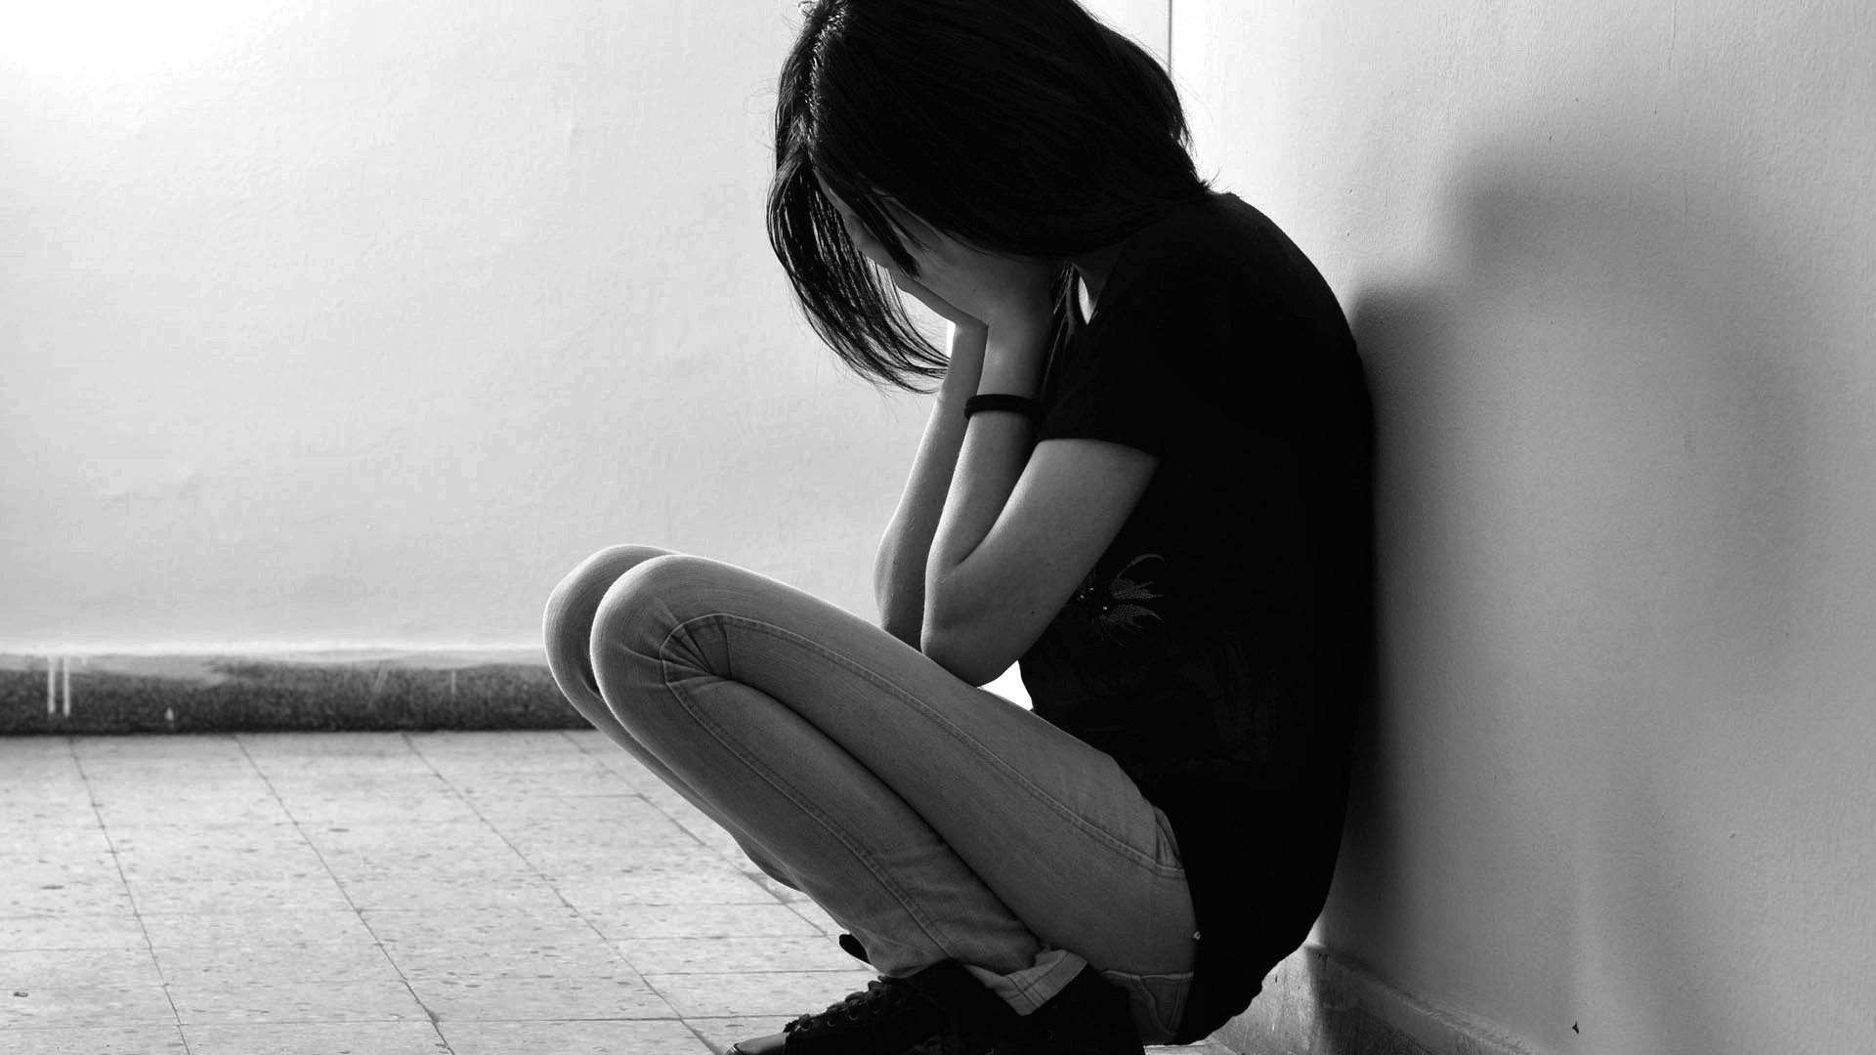
I’m lost.

Slide 25
I cut.
…blood paints my skin…
The screams of my little sister shatter the mirror.

Slide 26
Food is life
Food is life
Food is life
Food is life
FOOD = LIFE
I am thawing.

Slide 27
In her most powerfully moving novel since Speak, award winning author Laurie Halse Anderson writes…

Slide 28
…exploring Lia’s struggle, her painful path to recovery, and her desperate attempts to hold on to the most important thing of all---hope.

Slide 29
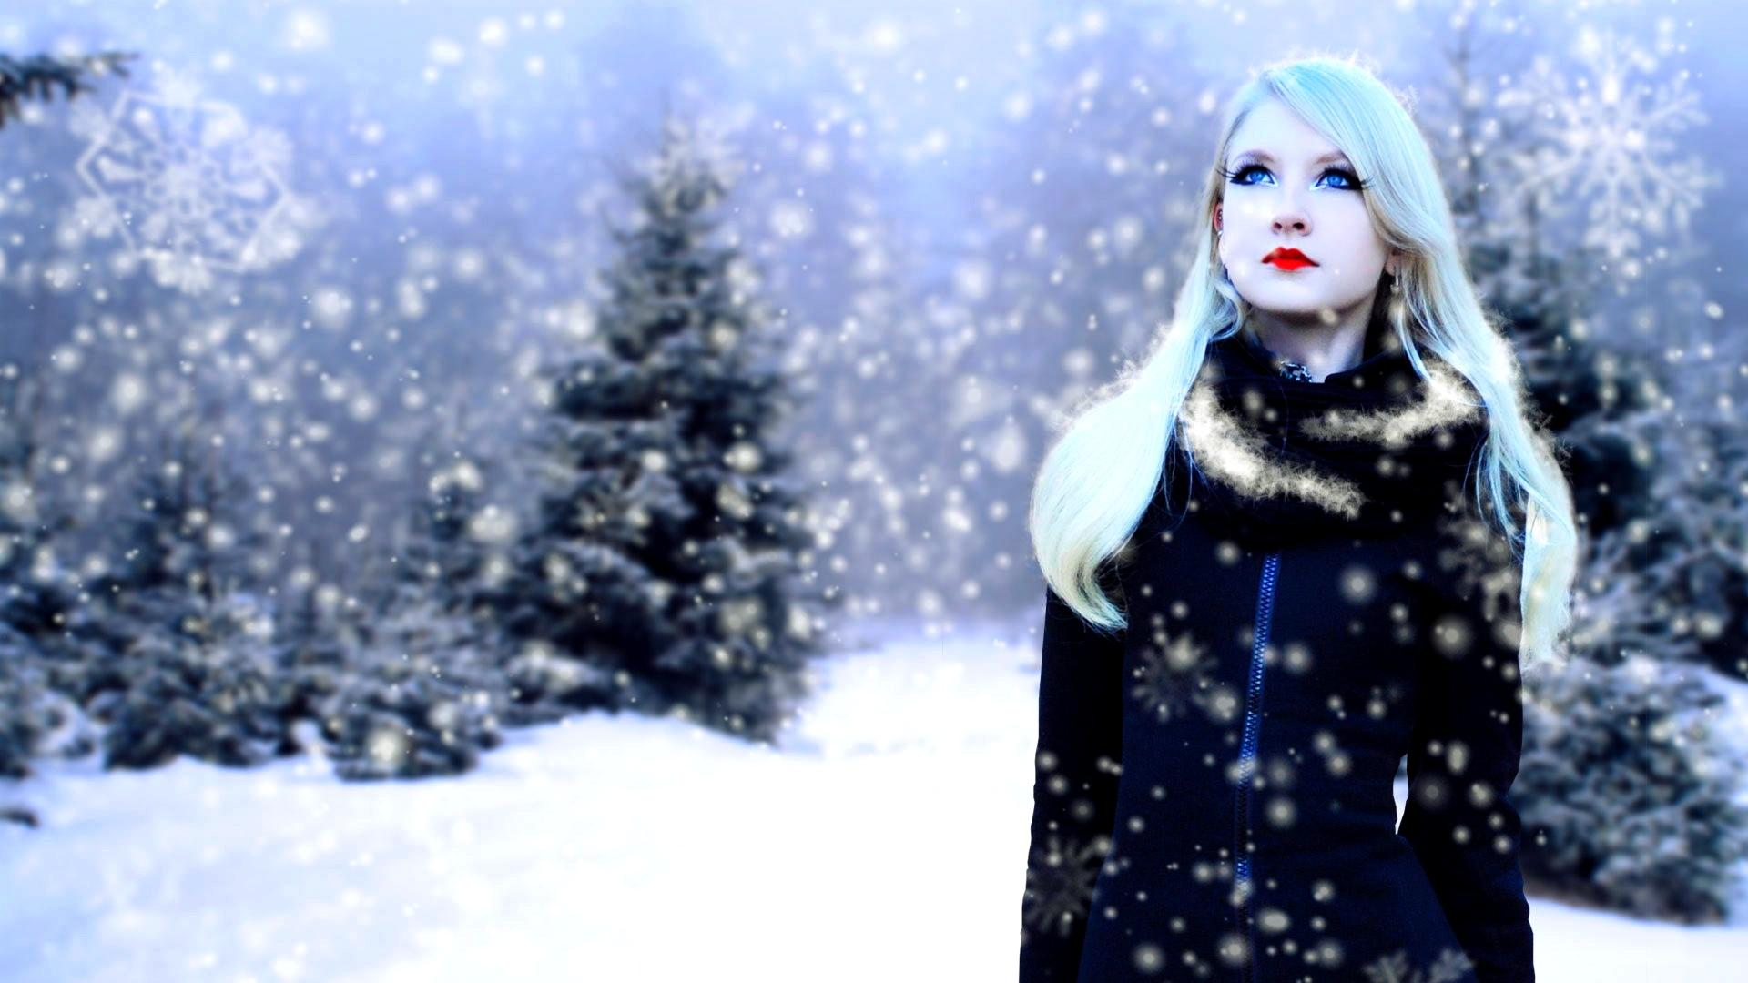
You’re not dead, but you’re not alive. You’re a
Wintergirl…

